Slide 1
Coding Basics
Part 2

Slide 2
More on Data Structure
Subsetting Vectors
Command: name_of_vector[position/s you want to extract]
Example 1: For the following vector:
vector_1 <- c(2,3,4,5,5,6)
What code do you need to write to extract the third element?
Code:
What code do you need to write to extract the fourth through sixth element?
Code:

Slide 3
Subsetting Matrices
Since matrices are two-dimensional organization of data, to subset a matrix you need a number for the row and a number for the column.
Command: name_of_matrix[row number, column number]

Slide 4
Example 2:
The following code defines a matrix, write out what the matrix will “look like” if we ran that code.
matrix(c(5,6,7,2,3,6), ncol = 2, byrow = FALSE)

Slide 5
Extract the element in row 3, column 1.
Code:
Output:
Extract the element in column 2, row 1.
Code:
Output:
Extract elements in column 2
Code:
Output:

Slide 6
Extract all elements in column 1
Code:
Output:
Extract all elements in row 2
Code:
Output:

Slide 7
Classes (Data Type)
numeric: any real number(s)
character: strings or individual characters, quoted
integer: any integer(s)/whole numbers
factor: categorical/qualitative variables
logical: variables composed of TRUE or FALSE
Date/POSIXct: represents calendar dates and times

Slide 8
How to check the class of a vector?
Command: class(name of the vector)
Example 3: In the following table, I define 5 different vectors. Type the code you would use to check the class of each vector and in the third column, type what the output would be if you ran that code.

Slide 9
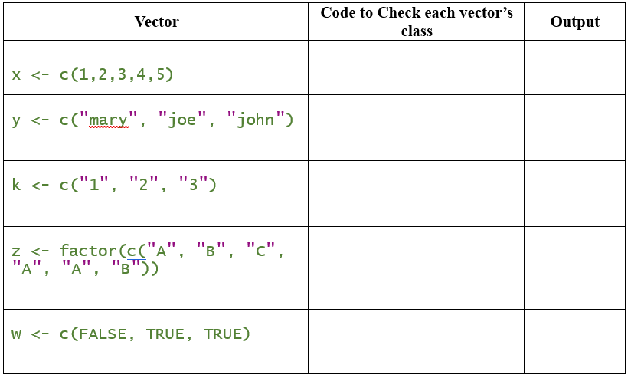

Slide 10
How to change a vector from one class to another class?
Use commands the following commands:
To change to a numeric vector: as.numeric(name of the vector)
To change to a character vector: as.character(name of the vector)
To change to a factor vector: as.factor(name of the vector)
To change to a logical vector: as.logical(name of vector)

Slide 11
Example 4: Suppose you have the following vector
vector_2 <- c("3", "5", "7", "9")
What is the class of this vector as it is?
Code:
Output:
How would you change it to numerical?
Code:

Slide 12
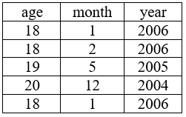
Dataframes
Dataframe: is a rectangular collection of variables (in the columns) and observations (in the rows). You can think of every column in a dataframe as a vector.

Slide 13
How to define dataframe?
Example 5: Define the following dataset as a dataframe.
Code:

Slide 14
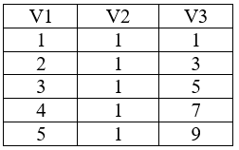
Example 6: Define the following dataset as a dataframe.
Code:

Slide 15
Subsetting dataframes
Command: name_of_dataframe$name_of_column
Example 7: What code would you write to pull/subset the column year from the dataframe in Example 5.
Code:
Output:

Slide 16
Example 8: What code would you write to check the class of the second column from the dataframe in Example 5.
Code:
Output:

Slide 17
Functions in R
For today we will study the following functions:
mean, median, min, max, sd, summary
Command: name_of_the_function(name of the vector)

Slide 18
Example 9: Suppose you have the following vector:
x <- c(1,1,3,5,5,6,7)
How would you compute the mean?
Code:
Output:
How would you compute the minimum value?
Code:
Output:
How would you compute the standard deviation?
Code:
Output:

Slide 19
Boolean Expressions
Boolean expressions: expressions that are either true or false
Commands: use ==, != , > , < , >= , or <= to compare two expressions.

Slide 20
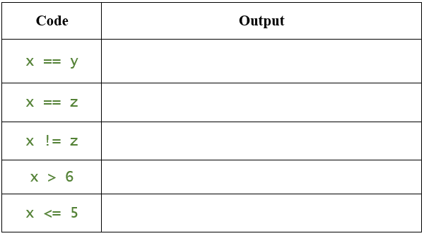
Example 10: Suppose you defined the following vectors:
        x <- c(4,5,6,7)
        y <- 4:7
        z <- c(4, 5, 7, 9)
What are the outputs if I ran the following lines of codes?

